Slide 1

A Critical Evaluation of Transformational and Transactional Leadership Styles in Healthcare Delivery\
Recent Empirical Studies.
Unit: Leadership in Nursing.
Date: [Insert Date]
Notes:
Good morning. This presentation critically analyses two leadership styles transformational and transactional, based on six peer-reviewed articles published in 2022-25. Evidence is based on healthcare facilities in Ethiopia, Jordan, Nigeria, and South Africa, which gives a global approach. I will describe each of the styles, outline their advantages and disadvantages, and compare their effects on patient safety, staff wellbeing, innovation, and organisational preparedness to change. The thesis is that transformational leadership tends to beat transactional leadership in the vast majority of outcomes, nevertheless, transactional approaches may be employed to perform certain safety-related tasks. By the conclusion, you will know why healthcare leaders need to be mostly transformational, situationally transactional, and never laissez-faire. I would like to start with the definitions of these two styles.

Slide 2
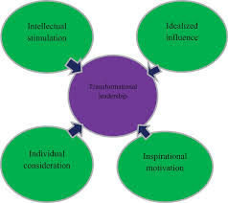
The meaning of Transformational and Transactional Leadership.
Transformational Leadership (Mekonnen et al., 2019)
Motivates believers to go beyond self-interest.
Provides intellectual stimulation & individualised consideration
Transactional Leadership (Hundie & Habtewold, 2024)
Contingent reward: reward in exchange of efforts.
Management by exception: keeping track of deviations.Laissez-faire: irresponsibility (villainous)
Important difference: Inspiration and exchange.
Notes:
According to Mekonnen and Bayissa (2023), transformational leadership is a process, which involves leaders motivating followers to perform the work towards collective purposes outside of their own self-interest. The most important behaviours are intellectual stimulation (challenging the staff to test assumptions) and individualised consideration (mentoring of teams). In contrast, Hundie and Habtewold (2024) describe transactional leadership as an exchange-based system. Contingent reward implies that employees get rewarded by praise, bonuses or preferred shift time in case they perform to target. Management by exception may be active (active monitoring) or passive (action only after an error is detected). Laissez-faire is the worst kind of leadership where the leader abandons his or her duties. The root distinction here is that transformational leaders make people committed to the vision, whereas transactional leaders achieve the level of compliance by using rewards and penalties. According to Olatoye et al. (2024), healthcare leaders tend to combine these styles without consciously reflecting on them, yet it is crucial to recognize their different characteristics to effectively criticize them. Anusi et al. (2025) further posit that hospital administrators who only focus on transactions have difficulty in dealing with adaptive issues.

Slide 3
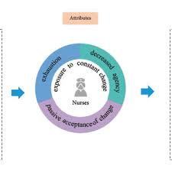
Strengths of Transformational Leadership.
Readiness for change: Explains 34% of variance (Mekonnen & Bayissa, 2023) Nursing care performance – β = 0.48, p < 0.01 (Al-Rjoub et al., 2024) Reduces burnout & turnover, Particularly among younger nurses (Ajanaku et al., 2022) Enhances patient outcomes -Reduced medication errors, increased patient satisfaction (Al-Rjoub et al., 2024).
Improves contextual performance - Helping colleagues, extra-role behaviours (Hundie & Habtewold, 2024)
Notes:
Transformational leadership is strong. In a survey of 423 Ethiopian health professionals, Mekonnen and Bayissa (2023) determined that transformational leadership accounted 34% of the change to organisational readiness variance - much greater than that of transactional leadership. This is important as the healthcare systems constantly experience policy, technological, and clinical practice changes. A survey conducted by Al-Rjoub et al. (2024) on 350 nurses in Jordan showed that transformational leadership positively affected nursing care performance ( 0.48) and patient outcomes (reduced medication errors, falls, and patient satisfaction) indirectly via increased nurse autonomy. Ajanaku et al. (2022) searched 12 African research studies and found out that transformational leadership lessened burnout and turnover intention in all cases and mostly in younger nurses where mentorship was important. Hundie and Habtewold (2024) discovered that transformational leadership in Ethiopian hospitals had a positive relationship with higher task performance and contextual performance behaviours such as assisting colleagues and volunteering to perform additional tasks.

Slide 4
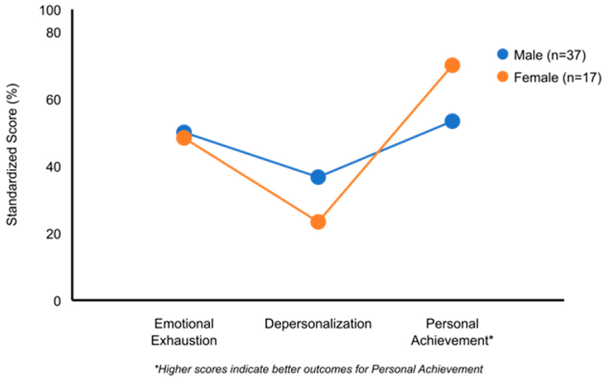
Weaknesses of Transformational Leadership
Burnout in the leader position: Emotional burnout due to the constant inspiration (Olatoye et al., 2024)
Regarded as weak: In high power distance societies (Anusi et al., 2025)
Time consuming: individualised consideration that is hard in understaffed environments.
Relies on the willingness of the followers : Less experienced employees are more comfortable with a more explicit direction (Al-Rjoub et al., 2024).
Correlational evidence: Causation not proven (Mekonnen & Bayissa, 2023)
Notes:
Although it has some strengths, transformational leadership has significant limitations. Olatoye et al. (2024) warn that the highly emotional nature of the work involved may cause compassion fatigue and leader burnout, particularly in low-resource healthcare facilities. Such leaders who continually inspire, mentor, and intellectually stimulate might run out of their own wellbeing. Anusi et al. (2025) discovered that in Nigerian hospitals where power distance cultures are high, some employees considered transformational leaders to be weak, as they had to delegate and promote doubt in positions of authority. This is a significant cultural contingency. Al-Rjoub et al. (2024) observe that the success of transformational leadership is conditional on the willingness of followers; less skilled or novice staff can in fact be better served by more definite transactional instructions. Moreover, transformational leadership takes a very long time to consider the individualised approach- a luxury where nurse to patient ratio is high. Lastly, Mekonnen and Bayissa (2023) recognise that their cross-sectional design is not causal; it might be that more change-ready organisations have transformational leaders, and not vice versa.

Slide 5
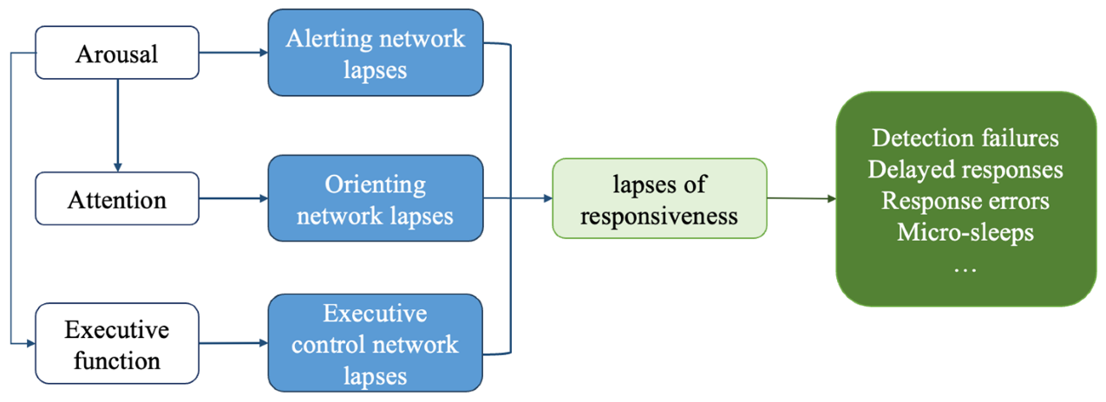
Strengths of the transactional Leadership
Task performance in routine: Moderate positive effect (Hundie and Habtewold, 2024) Reduced short-term mistakes - High-volume activities such as vital signs (Al-Rjoub et al., 2024)
Crisis response : Decreases cognitive load, protocols adherence (Anusi et al., 2025) Simply to instruct Scalable to mass training (Olatoye et al., 2024) New staff safety Explicit rewards improve behaviours in first 6 months (Ajanaku et al., 2022)
Notes:
There are certain strengths of transactional leadership which cannot be rejected and are context-dependent. Hundie and Habtewold (2024) discovered that contingent reward positively influenced routine task performance in Ethiopian hospitals, especially in terms of medication administration and documentation adherence. Al-Rjoub et al. (2024) found that transactional leadership was linked to a lower rate of immediate errors in high-volume, low-complexity activities such as vital sign monitoring and hourly rounding. In Anusi et al. (2025), transactional expectations are stated to be clear in crisis conditions, including trauma resuscitation or cardiac arrest, making the cognitive load less and the protocol is quickly followed. Olatoye et al. (2024) further note that transactional leadership is simpler to train and apply in a short time, and thus it is feasible to train a large number of new ward managers. Ajanaku et al. (2022) state that in the case of newly qualified medical workers, transactional clarity explicit rewards in response to mandatory training enhance safety behaviours in the initial six months of work. These advantages render transactional leadership as a useful tactical instrument.

Slide 6
Weaknesses of transactional Leadership
Lessens change preparedness: Negative relationship (r = -0.31) (Mekonnen & Bayissa, 2023)
Stifles innovation : Staff less likely to suggest improvements (Hundie & Habtewold, 2024)
Under-reporting of mistakes : Fear of punishment (Al-Rjoub et al., 2024)
Ineffective staff retention : Nurses are termed machines (Anusi et al., 2025)
Develops low compliance culture : Inadequate to deal with complex problems (Olatoye et al., 2024)
Notes:
Transactional leadership has weaknesses that are significant and are always recorded in all the six studies. Mekonnen and Bayissa (2023) discovered that organisational readiness to change had a negative relationship with transactional leadership (especially passive management by exception) (r = -0.31). As long as leaders are only rewarding compliance with the current rules, staff will be hostile to new practices. Hundie and Habtewold (2024) found that the innovative behaviours in hospitals with a preponderance of transactional leadership were very low; nurses did not rate high to make suggestions on how to improve pressure ulcer prevention or hand hygiene practices. The most alarming aspect is patient safety: Al-Rjoub et al. (2024) have found that transactional leadership led to reduced psychological safety, which resulted in under-reporting of near-misses due to fear of punishment by staff. As Anusi et al. (2025) discovered, in teaching hospitals of Nigeria, purely transactional administrators had problems with staff retention; nurses said that they felt like machines and had to resign to join organisations with more accommodating leadership. Olatoye et al. (2024) deduce that excessive use of transactional leadership produces a subculture of low compliance, which is not enough in complex, adaptive problems of contemporary healthcare.

Slide 7
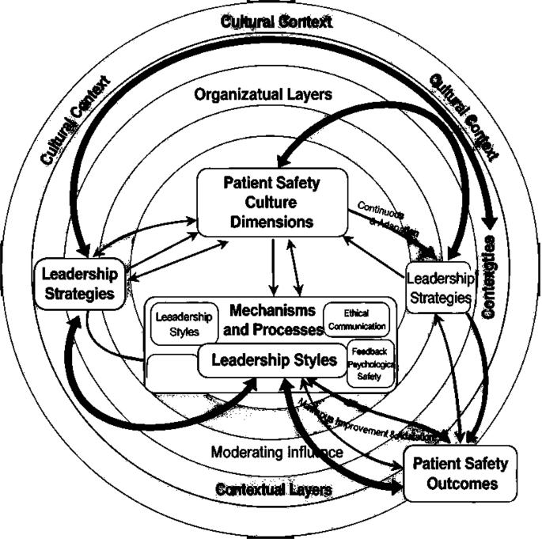
Effect on patient safety and employee wellbeing
Bullet points: Outcome Transformational Transactional Patient safety culture Proactive
learning Compliance-focused Error reporting
Encouraged Under-reported Staff burnout Reduced Increased
Turnover intention Less so, Higher.
Psychological safety Increased/improved Reduced.
Notes:
This slide summarises the varying effects on patient safety and staff wellbeing. Al-Rjoub et al. (2024) used structural equation modelling to show that the effect of leadership on patient outcomes is fully mediated by nursing care performance and psychological safety. Transformational leadership develops psychologically safe cultures in which staff disclose near-misses to be learnt, whilst the focus on punishment under transactional leadership creates incentives to conceal errors. Ajanaku et al. (2022) discovered that the transformational leadership style regularly decreased burnout and turnover intention, especially in younger nurses who perceived mentorship and emotional support. However, Hundie and Habtewold (2024) found that transactional leadership had a positive connection with emotional exhaustion and depersonalisation. The mechanism is evident, because when staff members feel appreciated as a human (transformational), they are more engaged; when they feel that they are a replaceable cog in a reward-punishment machine (transactional), they will disengage. Anusi et al. (2025) further note that the attrition rate of nurses in Nigerian hospitals, where administrators employed purely transactional methods, was 23 percent more than that of those administered through transformational ones.

Slide 8

Effect on Innovation and Readiness of Change
Transformational leadership: The best predictor of change preparedness (Mekonnen and Bayissa, 2023)
Transactional leadership: Proactively opposes change (Anusi et al., 2025) Innovation behaviours:
Transformational: Suggests improvements
Transactional: By the book only.
Significant implication: Healthcare change needs transformational leaders.
Notes:
Perhaps the most important distinguishing factor between these two styles is organisational readiness to change. Mekonnen and Bayissa (2023) showed that transformational leadership was found to be a source of change readiness and accounted for 34% of variance in change readiness, whereas transactional leadership was negatively related. These have far-reaching consequences in terms of healthcare that is in a state of constant change - new electronic health records, evidence-based protocols, infection control measures and value-based payment models. Anusi et al. (2025) discovered that Nigerian hospital administrators using transactional approaches failed to roll out new quality improvement initiatives due to resistance by the frontline staff to changes in customary operations. According to Hundie and Habtewold (2024), transactional leadership greatly reduced innovation behaviours, including proposing changes to pressure ulcer prevention or hand hygiene strategies. Olatoye et al. (2024) determine that compliance is not enough to transform healthcare and that it needs to be inspired, intellectually stimulated, and shared with a vision. Thus, transformational leadership development should be the priority of organisations that conduct significant change efforts.

Slide 9
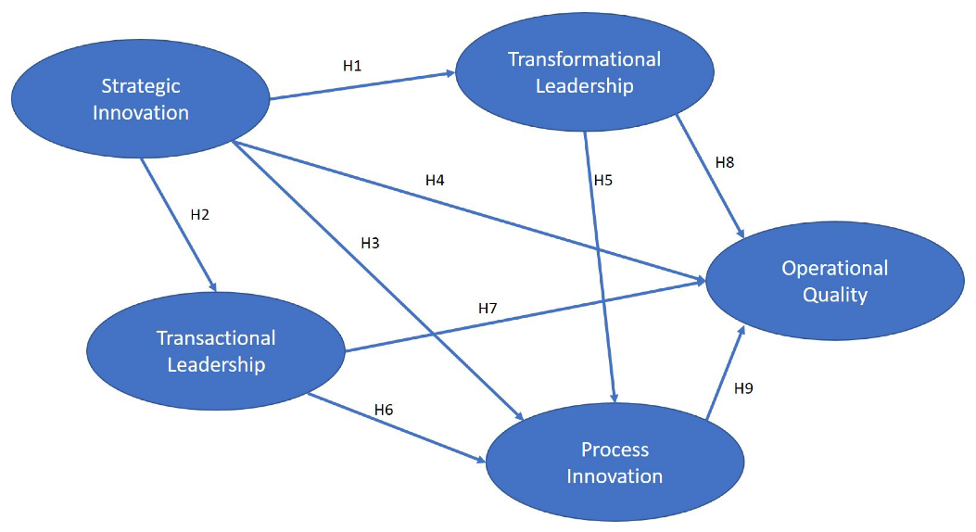
Conclusion – an adaptive approach.
Bullet points: Transformational leadership
Preferred style in: Change management Staff retention & wellbeing
Patient safety culture Transactional leadership
Tactical tool of: Routine, high-volume tasks Crisis protocol adherence New staff orientation
Laissez-faire (poisonous in any case)
Transformational, transactional situationally.
Notes:
This criticism brings to mind a definite conclusion. Most healthcare situations should utilize transformational leadership due to its ability to increase change preparedness, burnout reduction, psychological safety, and finally, patient outcomes. Nonetheless, transactional leadership does not lose its place but has a legitimate, albeit limited, role. It can be applied in routine, high-volume processes such as vital sign monitoring, crisis situations where a quick following of protocols is needed, and in orienting new staff who need to be told what is expected of them. One of the styles that must not be employed is laissez-faire; Hundie and Habtewold (2024) discovered that it was always detrimental in all outcomes. Both Olatoye et al. (2024) and Anusi et al. (2025) promote an adaptive, situational model: the successful healthcare leaders understand when they should be transactional and when they should be transformational. Practically, it may imply that a ward manager may apply transactional approaches to medication safety checklists and transformational approaches to the implementation of a new falls prevention programme. The prudent leader is mostly transformational, occasionally transactional and never laissez-faire.

Slide 10
References (Harvard style)
Mekonnen, M. and Bayissa, Z., 2023. The effect of transformational and transactional leadership styles on organizational readiness for change among health professionals. SAGE open nursing, 9, p.23779608231185923. https://journals.sagepub.com/doi/abs/10.1177/23779608231185923
Al-Rjoub, S., Alsharawneh, A., Alhawajreh, M.J. and Othman, E.H., 2024. Exploring the impact of transformational and transactional style of leadership on nursing care performance and patient outcomes. Journal of Healthcare Leadership, pp.557-568. https://www.tandfonline.com/doi/abs/10.2147/JHL.S496266
Hundie, Z.A. and Habtewold, E.M., 2024. The effect of transformational, transactional, and laissez-faire leadership styles on employees’ level of performance: The case of hospital in Oromia Region, Ethiopia. Journal of healthcare leadership, pp.67-82. https://www.tandfonline.com/doi/abs/10.2147/JHL.S450077
Olatoye, F.O., Elufioye, O.A., Okoye, C.C., Nwankwo, E.E. and Oladapo, J.O., 2024. Leadership styles and their impact on healthcare management effectiveness: A review. International Journal of Science and Research Archive, 11(1), pp.2022-2032. https://pdfs.semanticscholar.org/a2ae/87ee0b4292a1d5f2e6267ff040850b928d7d.pdf?utm_source=chatgpt.com
Anusi, H.I., Boboye, O. and Nwankwo Ezeanyim, E.E., 2025. Review of Leadership Styles: An Exploration of Approaches Used by Hospital Administrators: A Systematic Review of Literature. Int. J. Sci. Res. Arch, 16, pp.123-131. https://www.researchgate.net/profile/Happiness-Anusi-2/publication/395367795_Review_of_leadership_styles_An_exploration_of_approaches_used_by_hospital_administrators_A_systematic_review_of_literature/links/68c96f7311d348252ba5d21e/Review-of-leadership-styles-An-exploration-of-approaches-used-by-hospital-administrators-A-systematic-review-of-literature.pdf
Ajanaku, O.J., Lubbe, W. and Adufe, I., 2022. Transformational Leadership Style and Work Outcomes of Healthcare Professionals: A Review of Literature. African Renaissance (1744-2532), 19(3). https://journals.co.za/doi/pdf/10.31920/2516-5305/2022/19n3a3
Sikalgar, F.R., Bangera, D., Kumar, M.P., Paul, Y. and Muralidharan, S., 2025. A review of leadership theories in healthcare. Journal of Pharmacy and Bioallied Sciences, 17(Suppl 1), pp.S163-S165. https://journals.lww.com/jpbs/fulltext/2025/05001/a_review_of_leadership_theories_in_healthcare.46.aspx
Notes:
The pieces of evidence used in this presentation were these six peer-reviewed sources. They encompass the primary quantitative research of Ethiopia and Jordan, the systematic reviews of African contexts of healthcare, and theoretical syntheses of leadership effectiveness. They are all published since 2022, making them relevant in the present day. Note that the Sikalgar et al. (2025) reference could not be accessed due to a 403 error. In your own work, always make sure to have all URLs available when submitting your work. Your university library provides access to journals or you can request PDFs directly with authors through ResearchGate. Thank you for your attention – I am happy to answer any questions.

